Slide 1

Backtracking
Design and Analysis of
Algorithms
Rupali Khare
Assistant Professor, DCEA, GLAU

Slide 2
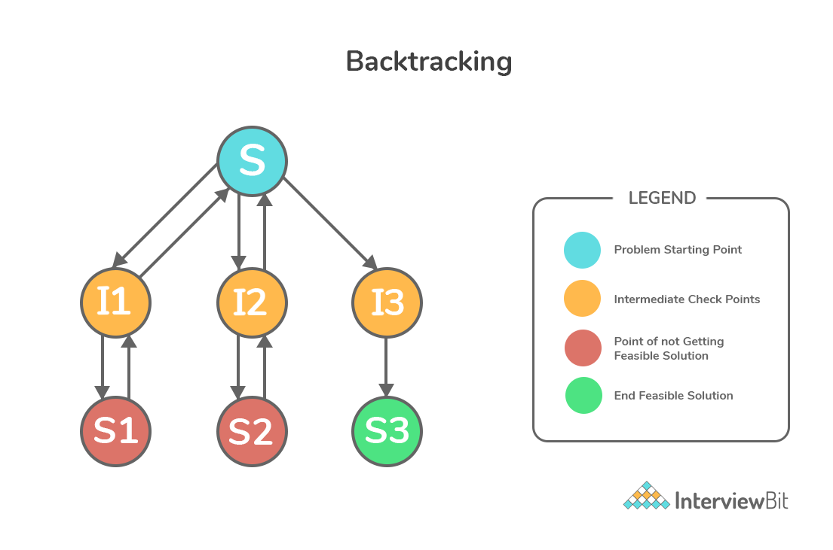
Backtracking
Backtracking algorithms determine problem solutions by systematically searching the solution space for the given problem instance.
This search is facilitated by using a tree organization for the solution space.
Depth first node generation with bounding functions is called backtracking.

Slide 3
State space tree
All paths from the root to other nodes define the state space of the problem.
Solution states are those problem states S for which the path from the root to S defines a tuple in the solution space.
Answer states are those solution states S for which the path from the root to S defines a tuple which is a member of the set of solutions.
The tree organization of the solution space will be referred to as the state space tree.

Slide 4
1. N-Queen Problem
The n-queens problem is a generalization of the 8-queens problem of n queens are to be placed on a n x n chessboard so that no two attack, i.e., no two queens are on the same row, column or diagonal.
Nqueens(k,n){
for i=1 to n{
if(place(k,i)){
x[k]=i
if (k==n){
for j=1 to n
print x[i]}
else
Nqueens(k+1,n)}}}
place(k,i){
for j=1 to k
if(x[j]==i || abs(x[j]-i ==abs(j-k))
return false
return true
}

Slide 5
N- Queen Problem
Placing n queens on the n x n chessboard, such that none of them attack one another (no two queens are in the same row, column or diagonal)

Slide 6
4-Queen Problem
The 4-queens problem is a generalization of 4 queens are to be placed on a 4 x 4 chessboard so that no two attack, i.e., no two queens are on the same row, column or diagonal.

Slide 7
4-Queen Problem
The 4-queens problem is a generalization of 4 queens are to be placed on a 4 x 4 chessboard so that no two attack, i.e., no two queens are on the same row, column or diagonal.

Slide 8
4-Queen Problem
The 4-queens problem is a generalization of 4 queens are to be placed on a 4 x 4 chessboard so that no two attack, i.e., no two queens are on the same row, column or diagonal.

Slide 9
8-Queen Problem
The 8-queens problem is a generalization of 8 queens are to be placed on a 8 x 8 chessboard so that no two attack, i.e., no two queens are on the same row, column or diagonal.

Slide 10
8-Queen Problem
The 8-queens problem is a generalization of 8 queens are to be placed on a 8 x 8 chessboard so that no two attack, i.e., no two queens are on the same row, column or diagonal.

Slide 11
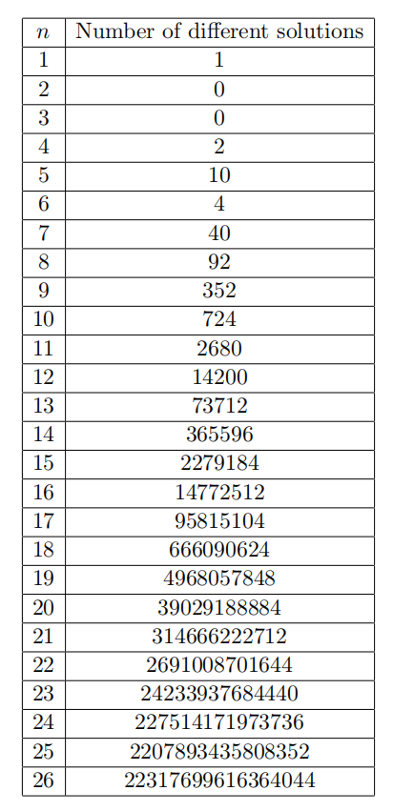
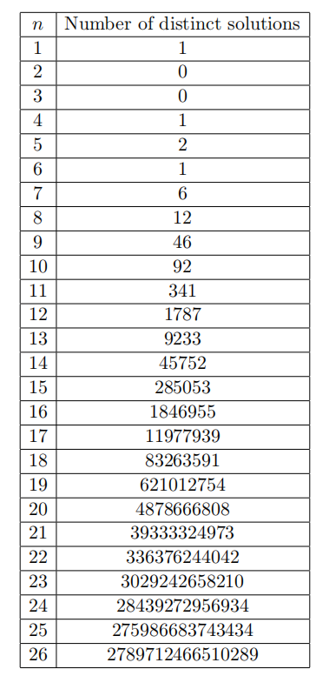
Number of Solution exists
The number of different solutions, not necessarily distinct, is known for n ≤ 26.
It is clear to see that the number of solutions grows exponentially.
The number of solutions that exist when n ≥ 27 is still an open problem.

Slide 12
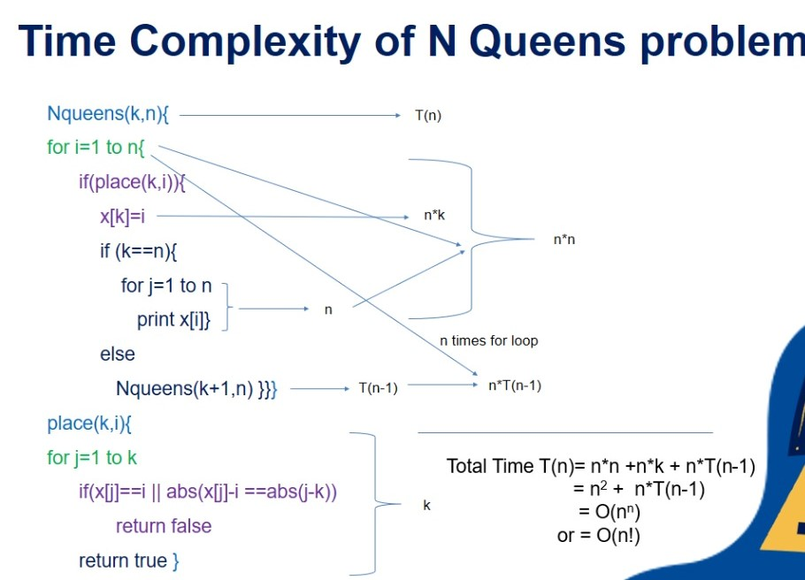
Time complexity

Slide 13
2. Sum of Subset Problem
Suppose we are given n distinct positive numbers (usually called weights) and we desire to find all combinations of these numbers whose sum is M. This is called the sum of subsets problem.
In this case the element X(i) of the solution vector is either one or zero depending upon whether the weight W(i) is included or not.
For a node at level i the left child corresponds to X(i) = 1 and the right to X(i) = 0.

Slide 14
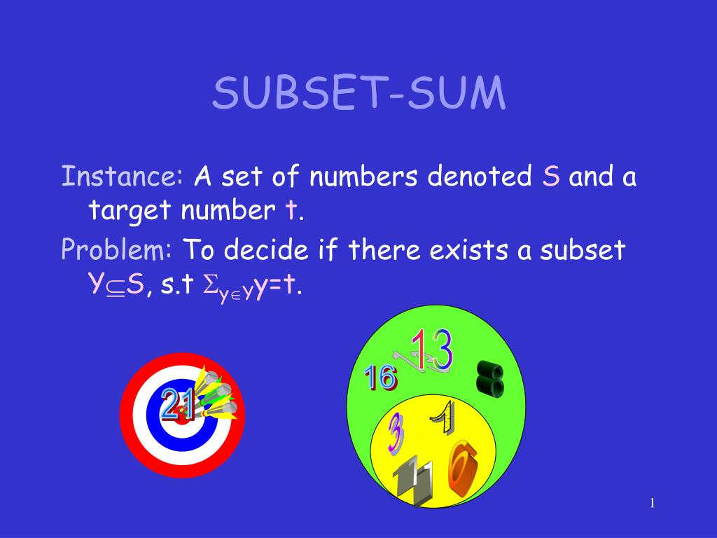
Sum of Subset

Slide 15
Sum of Subset Problem
The state space tree generated by procedure SUMOFSUB while working on the instance n = 6, M = 30 and W(l :6) = (5, 10, 12, 13, 15, 18).

Slide 16
Sum of Subset Problem
The state space tree generated by procedure SUMOFSUB while working on the instance
n = 6, M = 30 and
W(l :6) = (5, 10, 12, 13, 15, 18).

Slide 17
Sum of Subset Problem
The state space tree generated by procedure SUMOFSUB while working on the instance
n = 6, M = 30 and
W(l :6) = (5, 10, 12, 13, 15, 18).
At nodes A, B and C
the output is respectively (1, 1, 0, 0, 1), (1, 0, 1, 1) and (0, 0, 1, 0, 0, 1).

Slide 18
Sum of Subset Problem

Slide 19
Recursive solution for Sum of Subset problem
// A recursive solution for subset sum problem
#include <stdio.h>
// Returns true if there is a subset of set[] with sun equal to given sum
bool SOS(int set[], int n, int sum)
{
// Base Cases
if (sum == 0)
return true;
if (n == 0 && sum != 0)
return false;
// If last element is greater than sum, then ignore it
if (set[n-1] > sum)
return SOS(set, n-1, sum);
/* else, check if sum can be obtained by any of the following
(a) including the last element
(b) excluding the last element */
return SOS(set, n-1, sum) || SOS(set, n-1, sum-set[n-1]);
}

Slide 20
Cont..
// Driver program to test above function
int main()
{
int set[] = {3, 34, 4, 12, 5, 2};
int sum = 9;
int n = sizeof(set)/sizeof(set[0]);
if (SOS(set, n, sum) == true)
printf("Found a subset with given sum");
Else
printf("No subset with given sum");
return 0;
}

Slide 21
Dynamic Programming solution for subset sum problem
// A Dynamic Programming solution for subset sum problem
#include <stdio.h>
// Returns true if there is a subset of set[] with sun equal to given sum
bool SOS (int set[], int n, int sum)
{ // The value of subset[i][j] will be true if there is a
// subset of set[0..j-1] with sum equal to i
bool subset[n+1][sum+1];
// If sum is 0, then answer is true
for (int i = 0; i <= n; i++)
subset[i][0] = true;
// If sum is not 0 and set is empty, then answer is false
for (int i = 1; i <= sum; i++)
subset[0][i] = false;

Slide 22
Cont.
// Fill the subset table in botton up manner
for (int i = 1; i <= n; i++)
{ for (int j = 1; j <= sum; j++)
{ if(j<set[i-1])
subset[i][j] = subset[i-1][j];
if (j >= set[i-1])
subset[i][j] = subset[i-1][j] || subset[i - 1][j-set[i-1]];
}
} /* // uncomment this code to print table
for (int i = 0; i <= n; i++)
{ for (int j = 0; j <= sum; j++)
printf ("%4d", subset[i][j]);
printf("\n");
}*/
return subset[n][sum];
}
// Driver program to test above function
int main()
{
int set[] = {3, 34, 4, 12, 5, 2};
int sum = 9;
int n = sizeof(set)/sizeof(set[0]);
if (isSubsetSum(set, n, sum) == true)
printf("Found a subset with given sum");
else
printf("No subset with given sum");
return 0;
}

